Slide 1
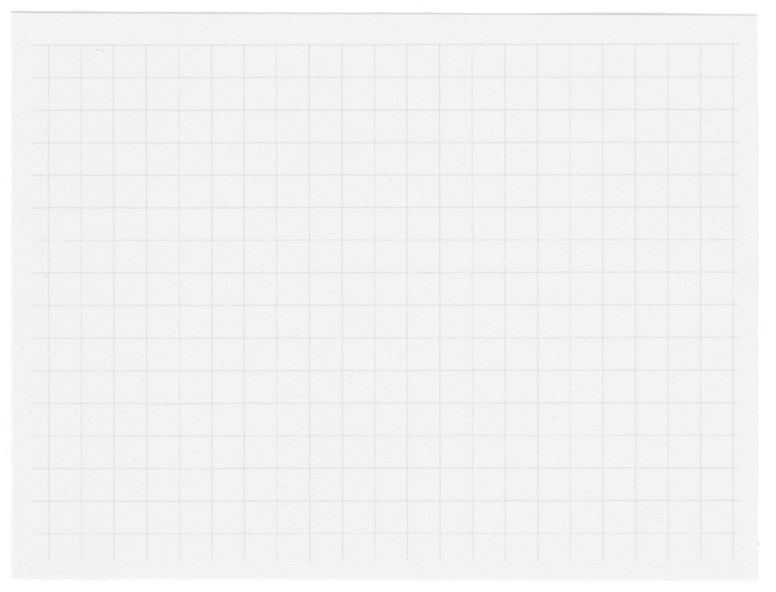












Hospital Management System
System for Receptionist

Slide 2
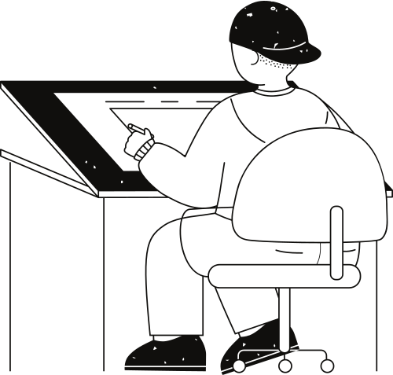





Agresha Shah
Roll No. : 82
Enrollment:
22002170110155
Yasvi Vaghasiya
Roll No. : 99
Enrollment:
22002170110199
Meet Our Team
Chirag Patel
Roll No. : 94
Enrollment:
22002170110107
Jiya Shah
Roll No. : 105
Enrollment:
22002170110164
SEM-3 CE A3 DIVISION
Henil Sutariya
Roll No. : 95
Enrollment:
22002171410058

Slide 3


Origin of the project
As managing data of hospital of paitents and doctors is very important concern for us .
And finding all these details in register and books is hard and risk of loosing those data is high .
So overcome these issues we have developed system for hospital’s reception desktop.

Slide 4
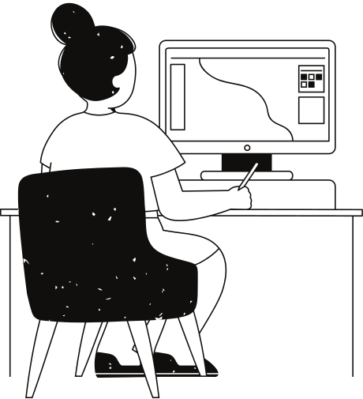
Base of Project
We have made these system using Python Programming language
In we have used Tkinter which is Inbuild Libaray or Module of python language which provide us to construct GUI , connected With MySql Database

Slide 5

Functionalities
Adding
New Patient
Checking Details Of Old Paitent
CRUD Operations Patient & Doctors
01.
03.
05
Adding
New Doctor
Checking Details of Old Doctor
02.
04

Slide 6

Merits
Made easy way for managing data
Easy way to manipulate Data
All Basics Validations
Friendly System

Slide 7
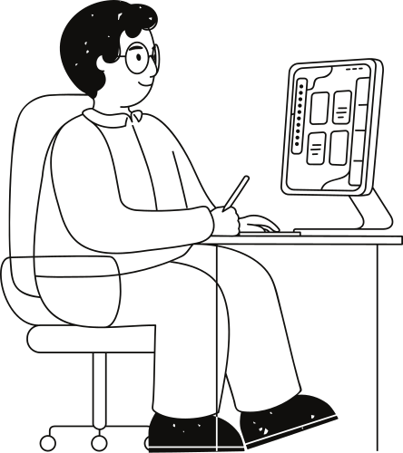
Future Scope
Setting These Mechanism From GUI to Websites
Increasing Features As per requiremnts
Integrating with Django framework
Making interactive GUI using customTkinter module

Slide 8

Thank you very much!

